Slide 1
Creating HTML file

Slide 2
Agenda
Creating HTML File

Slide 3
Creating HTML File
Step 1: Open Visual Studio Code
Step 2: Click on file/New File.
Step 3 : Write html code.
Step 4: Save the File with .html extension at any location of your choice.
Step 5: Now you can edit your html file(if required) later.

Slide 4
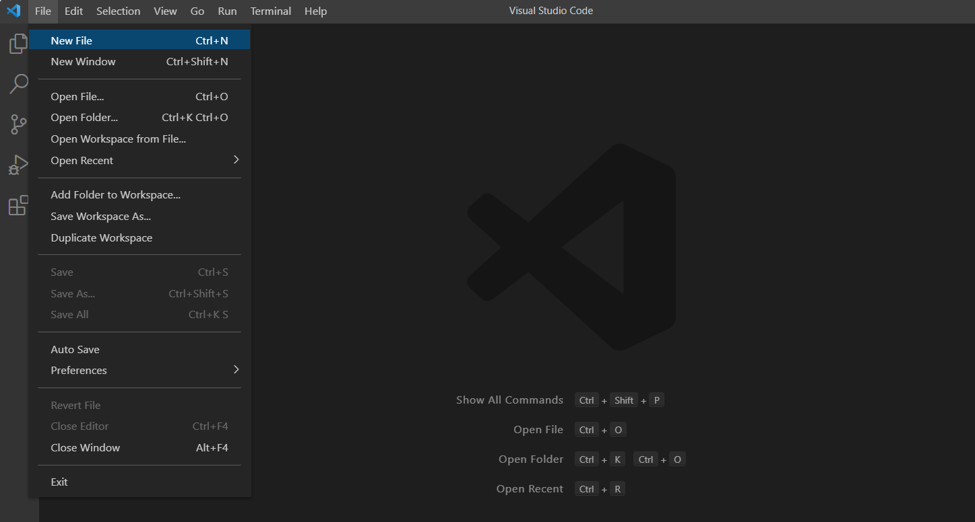
Creating New File

Slide 5
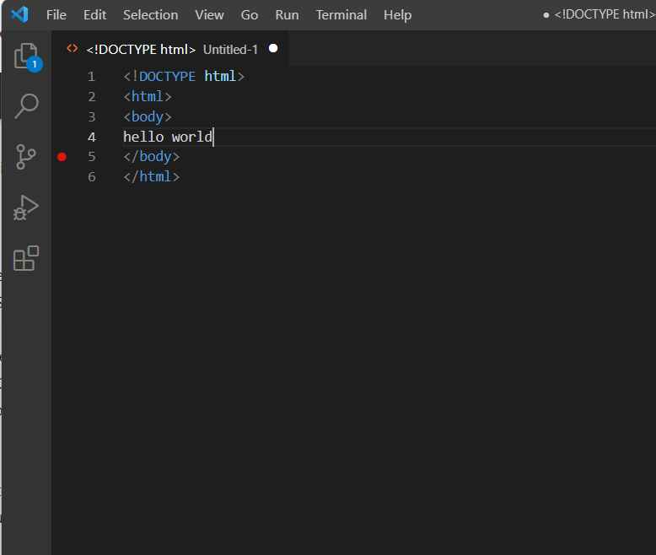
Writing HTML Code

Slide 6
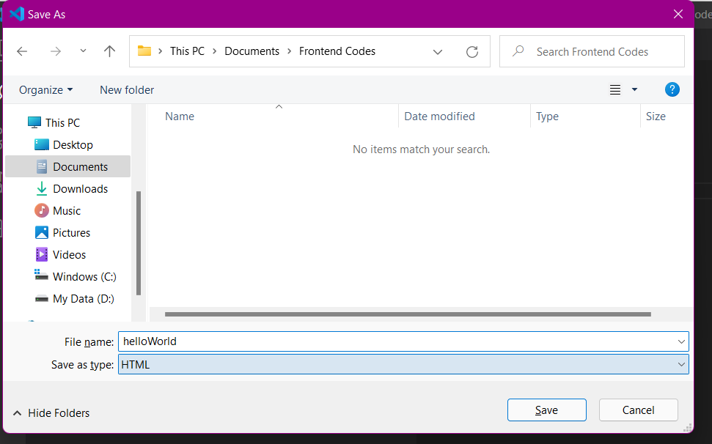
Saving File With .html Extension

Slide 7
Summary
We have seen how to create HTML files in VSC and the use of explorer in VSC.
DO NOT WRITE ANYTHING
HERE. LEAVE THIS SPACE FOR
WEBCAM

Slide 8
Thank You
Proprietary content. ©Great Learning. All Rights Reserved. Unauthorized use or distribution prohibited

